Slide 1
Passerelles numériques
A Gateway for Life
Chapter5: Event
Notes:
What is syntax?

Slide 2
Content
What is an event?
HTML event attributes
The click event
The mouseover event
The mouseout event
The keyup event
The keydown event
Event Bubbling
Prevent Default()

Slide 3
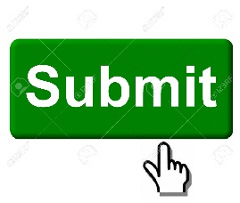
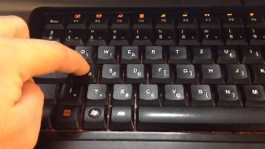

What Is An Event?
Something that happens on an element is called event.
  Ex:
    You click on a submit button
    You press a key
    You move mouse pointer over an image.
The task ( code ) that responds to the event is called event handler usually function.
Notes:
Event handler are the code actions that can be detected by JavaScript.
-​​​ Detected: បានរកឃើញ

Slide 4
HTML Event Attributes
To register an event to an element, you can use event attributes.
HTML provides many event attributes such as:
  Onclick, ondblclick, onmousedown, etc …
To respond to an event, usually you use function such as alert function.
Notes:
- Onclick : A mouse click on on the element.
- Ondblclick: A mouse double click on the element
- Onmousedown: A mouse pressed down on the element button.

Slide 5
HTML Event Attributes
How to register an event:
  Define the event source, which element that event happens on.
  Define the event type that will occur (click or mouse over)
  Define the event handler, function to responds to the event
  Register the event, HTML event attributes or JavaScript.
Notes:
- Occur: កើតឡើង

Slide 6
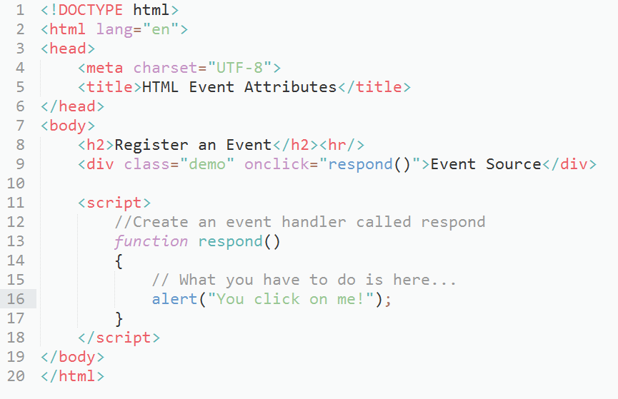
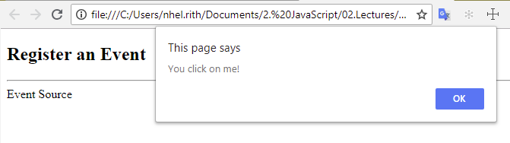
HTML Event Attributes

Slide 7
The Click Event
The click event occurs when you click on an element.
Most of the element can have this event:
  p, div, button, submit, body, …
You use the onclick attribute to register this event.
You can use JS to register this event too.
Notes:
Demo how to use JS to register this event: Go to folder Demo -> demo1.html
https://www.w3schools.com/jsref/dom_obj_event.asp

Slide 8
The Mouse Over Event
This event occurs when you move mouse pointer over an element.
You use the onmouseover attribute to register this event

Slide 9
The Mouse Over Event
<head>
<title>Mouse Over Event</title>
<style type="text/css">
.box{width: 120px; height:120px;background:#ccc;}
</style>
</head>
<body>
<h2>Mouse Over Event</h2><hr/>
<div class="box" onmouseover="showMessage()"></div>
<script>
function showMessage()
{
alert("Mouse Over!");
}
</script>
</body>

Slide 10
The Mouse Out Event
This event occurs when you move mouse pointer out of an element.
You use the onmouseout attribute to register this event.

Slide 11
The Mouse Out Event
<head>
<title>Mouse Out Event</title>
<style type="text/css">
.box{width: 120px; height:120px;background:#ccc;}
</style>
</head>
<body>
<h2>Mouse Out Event</h2><hr/>
<div class="box" onmouseout="showMessage()"></div>
<script>
function showMessage()
{
alert("Mouse Out!");
}
</script>
</body>

Slide 12
The Key Up Event
This event occurs when you release the key up.
Most of the element can have this event:
  Textarea, input field …
You use the onkeyup attribute to register this event.
Notes:
Show them in the resources folder

Slide 13
The Key Up Event
<body>
<input type='text' size='32' onkeyup="showMessage()" id='txtInput' />
<script>
function showMessage()
{
alert("key is up");
}
</script>
</body>

Slide 14
The Key Down Event
This event occurs when you hold the key down.
Most of the element can have this event:
  Textarea, input field …
You use the onkeydown attribute to register this event.
Notes:
Show them in the resources folder

Slide 15
The Key Down Event
<body>
<input type='text' size='32' onkeydown="showMessage()" id='txtInput' />
<script>
function showMessage()
{
alert("key is up");
}
</script>
</body>

Slide 16
Event Bubbling
When an event happens on an element, it first runs the handlers on it, then on its parent, then all the way up on other ancestors.
Notes:
The event bubbles up from parent to parent until it is handled, or until it reaches the document object.
https://javascript.info/bubbling-and-capturing

Slide 17
example
<style>
body * {
margin: 10px;
border: 1px solid blue;
}
</style>
<form onclick="alert('form')">FORM
<div onclick="alert('div')">DIV
<p onclick="alert('p')">P</p>
</div>
</form>

Slide 18
preventDefault()
Definition and Usage
The preventDefault() method cancels the event. It means the default action that belongs to the event will not occur.
For example, this can be useful when:
- Clicking on a “Submit” button, prevent it from submitting a form
- Clicking on a link, prevent the link from following the URL

Slide 19
example
<h1 id="greeting"></h1>
<form action="#">
<button id="sendBtn">Send</button>
</form>
<script>
var sendBtn = document.getElementById('sendBtn');
sendBtn.addEventListener("click",sayHello);
function sayHello(){
document.getElementById('greeting').innerHTML = "Hello"; }
</script>

Slide 20
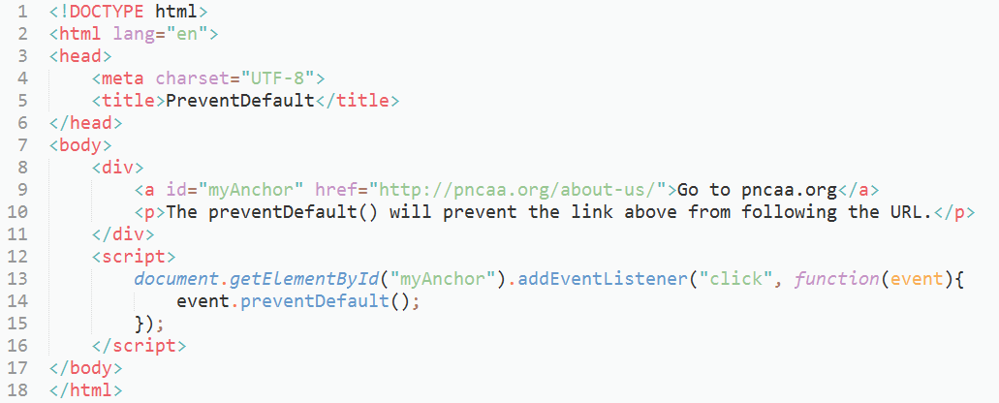
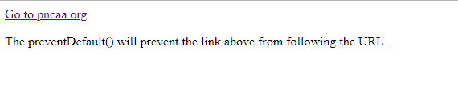
preventDefault()

Slide 21
Q&A

Slide 22
What have you learned?
Notes:
Ask student to give quick summary what they have learned

Slide 23
Summary
What is an event?
HTML event attributes
The click event
The mouseover event
The mouseout event
The keyup event
The keydown event
Event Bubbling
Prevent Default()

